Slide 1
NSQ1, Session 9
neo4j Modelling

Slide 2
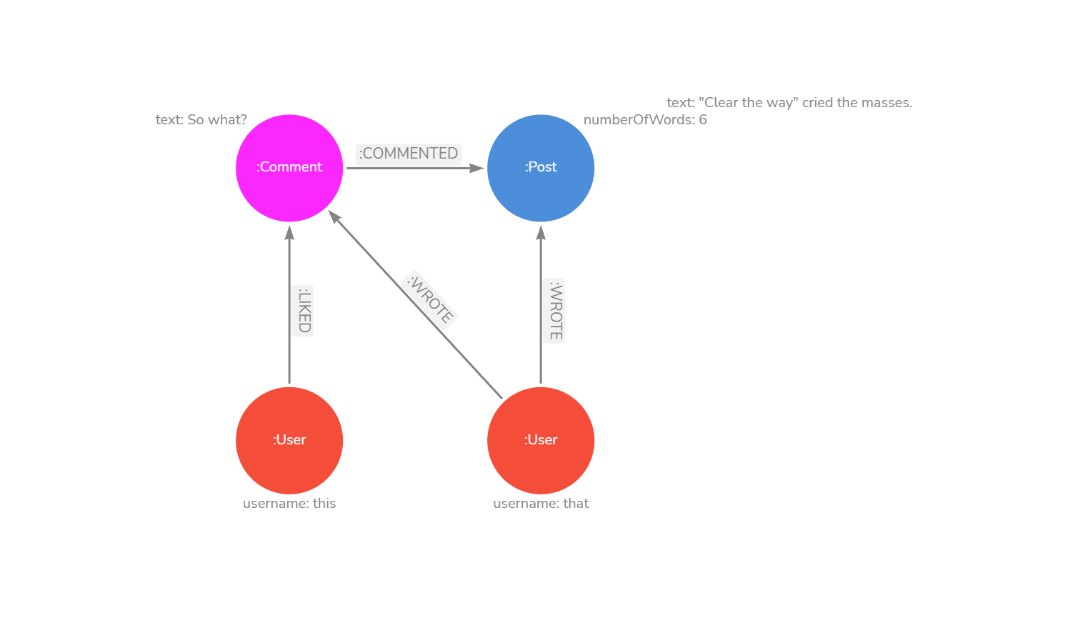
Modelling
Modelling by example
Recommended modelling method by neo4j
Use https://arrows.app

Slide 3
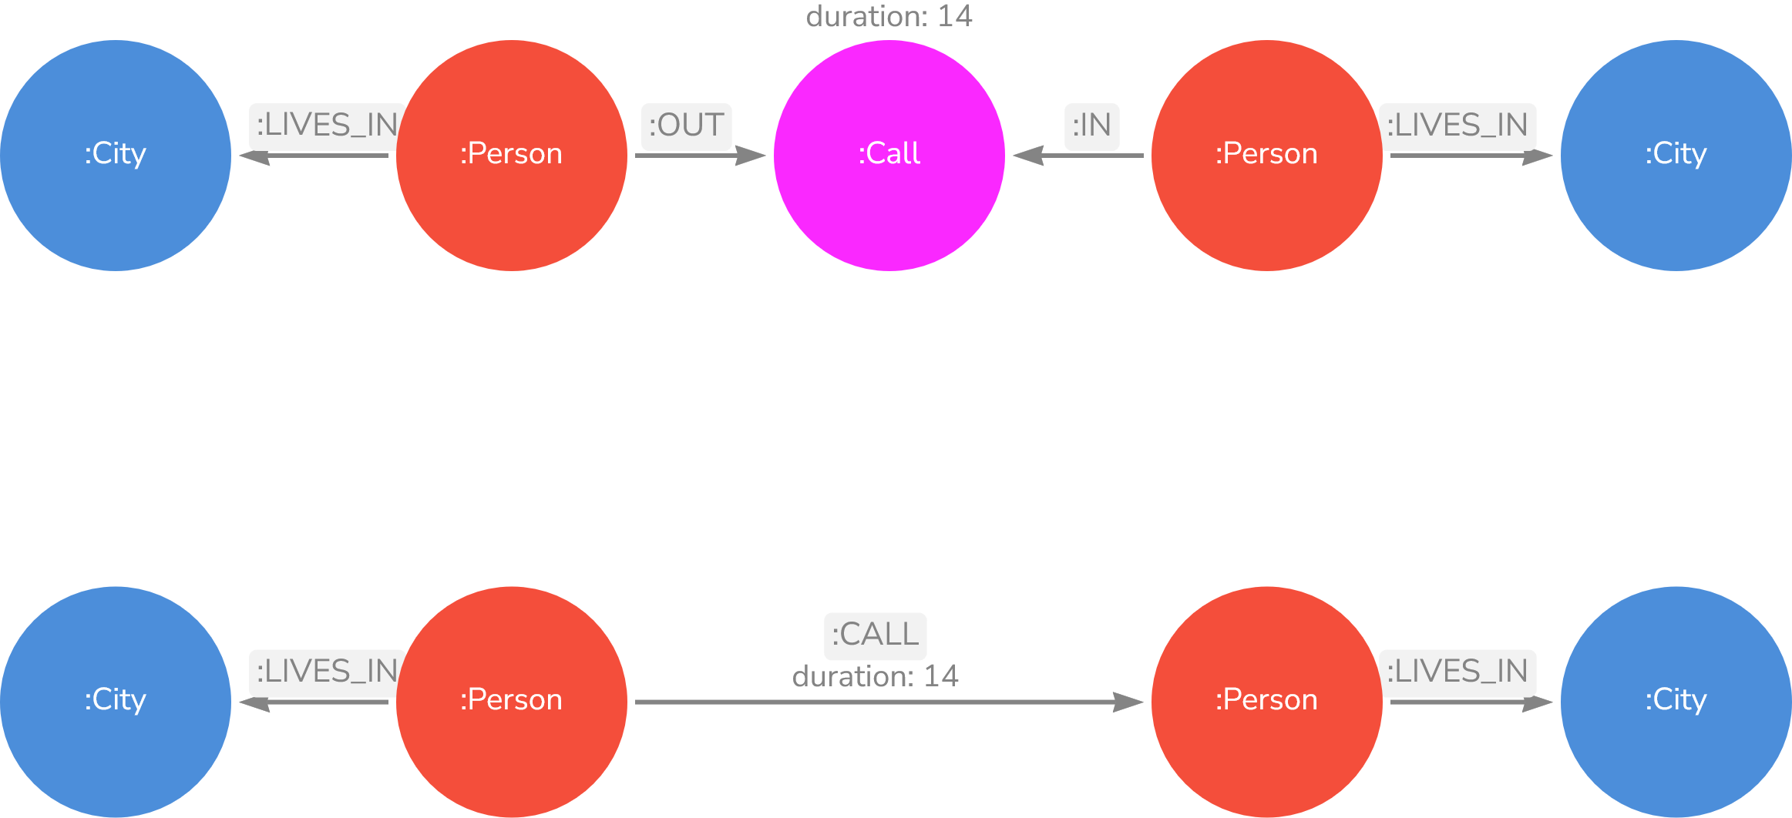
Modelling choices

Slide 4
Code difference
Call is a node
Call is a relationship
MATCH (c:Call{duration: 0})
WHERE c.from.month = 5
RETURN COUNT(c) AS missed
MATCH ()-[c:CALL{duration: 0})]-()
WHERE c.from.month = 5
RETURN COUNT(c) AS missed

Slide 5
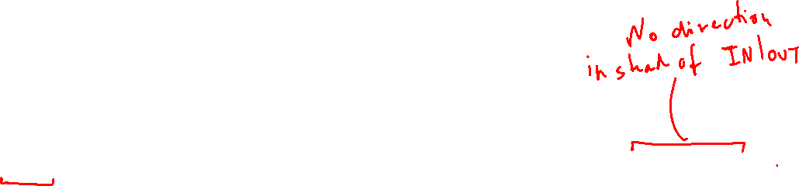
Code difference
Call is a node
Call is a relationship
MATCH (x:Person{gender:"Woman"}) -[:IN|OUT]-> (call:Call)
WHERE datetime.truncate('day', call.from) = datetime({year: 2019, month: 4, day: 25})
RETURN x, SUM(call.duration) AS duration
ORDER BY duration
LIMIT 1
MATCH (x:Person{gender:"Woman"})-[call:CALL]-()
WHERE datetime.truncate('day', call.from) = datetime({year: 2019, month: 4, day: 25})
RETURN x, SUM(call.duration) AS duration
ORDER BY duration
LIMIT 1

Slide 6
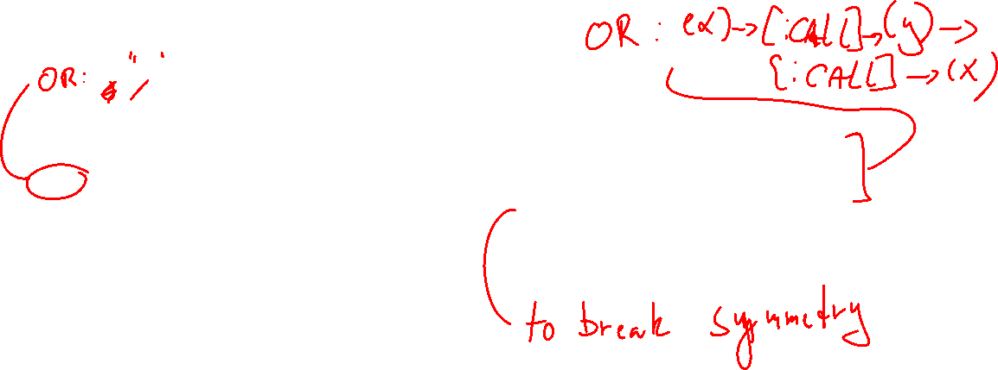
Code difference
Call is a node
Call is a relationship
MATCH (x:Person)-[:OUT]->(:Call)<-[:IN]-(y:Person)
MATCH (y)-[:OUT]->(:Call)<-[:IN]-(x)
WHERE x.number < y.number
RETURN COUNT(DISTINCT [x, y]) AS callers
MATCH (x:Person)-[:CALL]->(y:Person)
MATCH (y)-[:CALL]->(x)
WHERE x.number < y.number
RETURN COUNT(DISTINCT [x, y]) AS callers

Slide 7
From ER-model to logical model
In relational model:
9-step algorithm with little to no leeway
In MongoDB:
A series of modelling choices using some guidelines
Focus on making pragmatic solutions
In Neo4j
A direct translation of ER into the database
No embedding
Little to no schema or constraints
Unique, property exists (not null), primary key
Only unique constraints in the community edition

Slide 8
ER-relationships and mapping
Most ER-diagram standards do not have directional relationships,
but UML class diagrams do:
They disappear in the mapping, though:
So most don't bother with them.

Slide 9
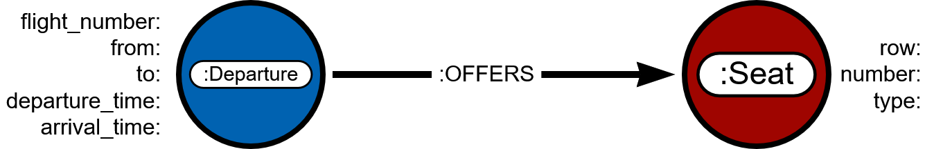
Logical Model vs Graph

Slide 10
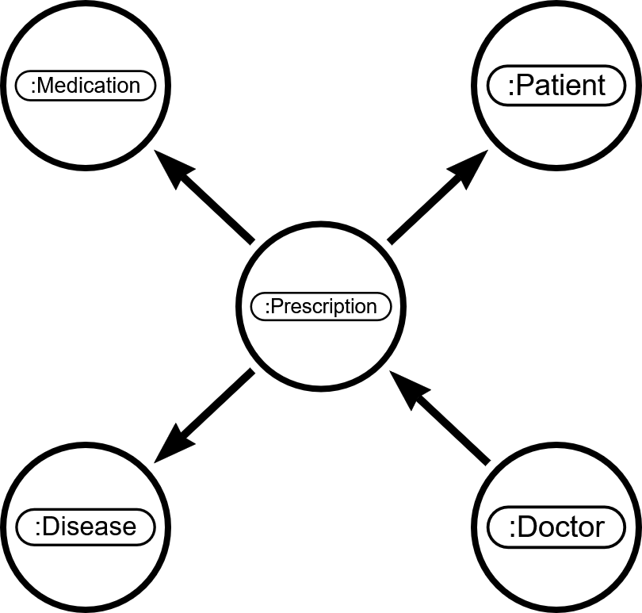

Exception: Higher-arity relationships
Prescribes

Slide 11
Design consideration
Design for use cases
In particular, design your relationships to be easy to match for
"Granulate" (value) nodes
Make own nodes for shared primitive values
Like Value Object pattern in OO
In-graph Indexes
Use relationships to ease searching

Slide 12
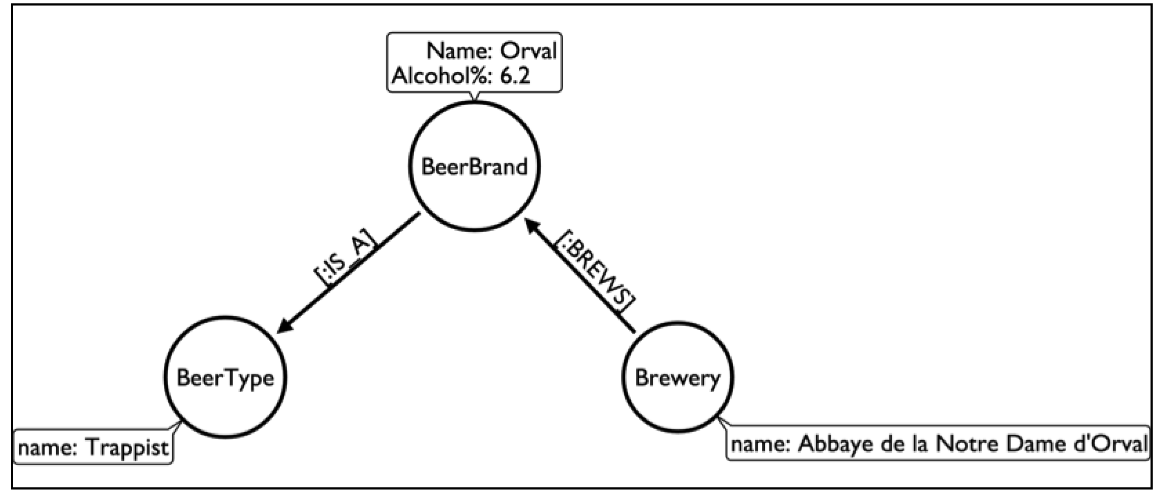
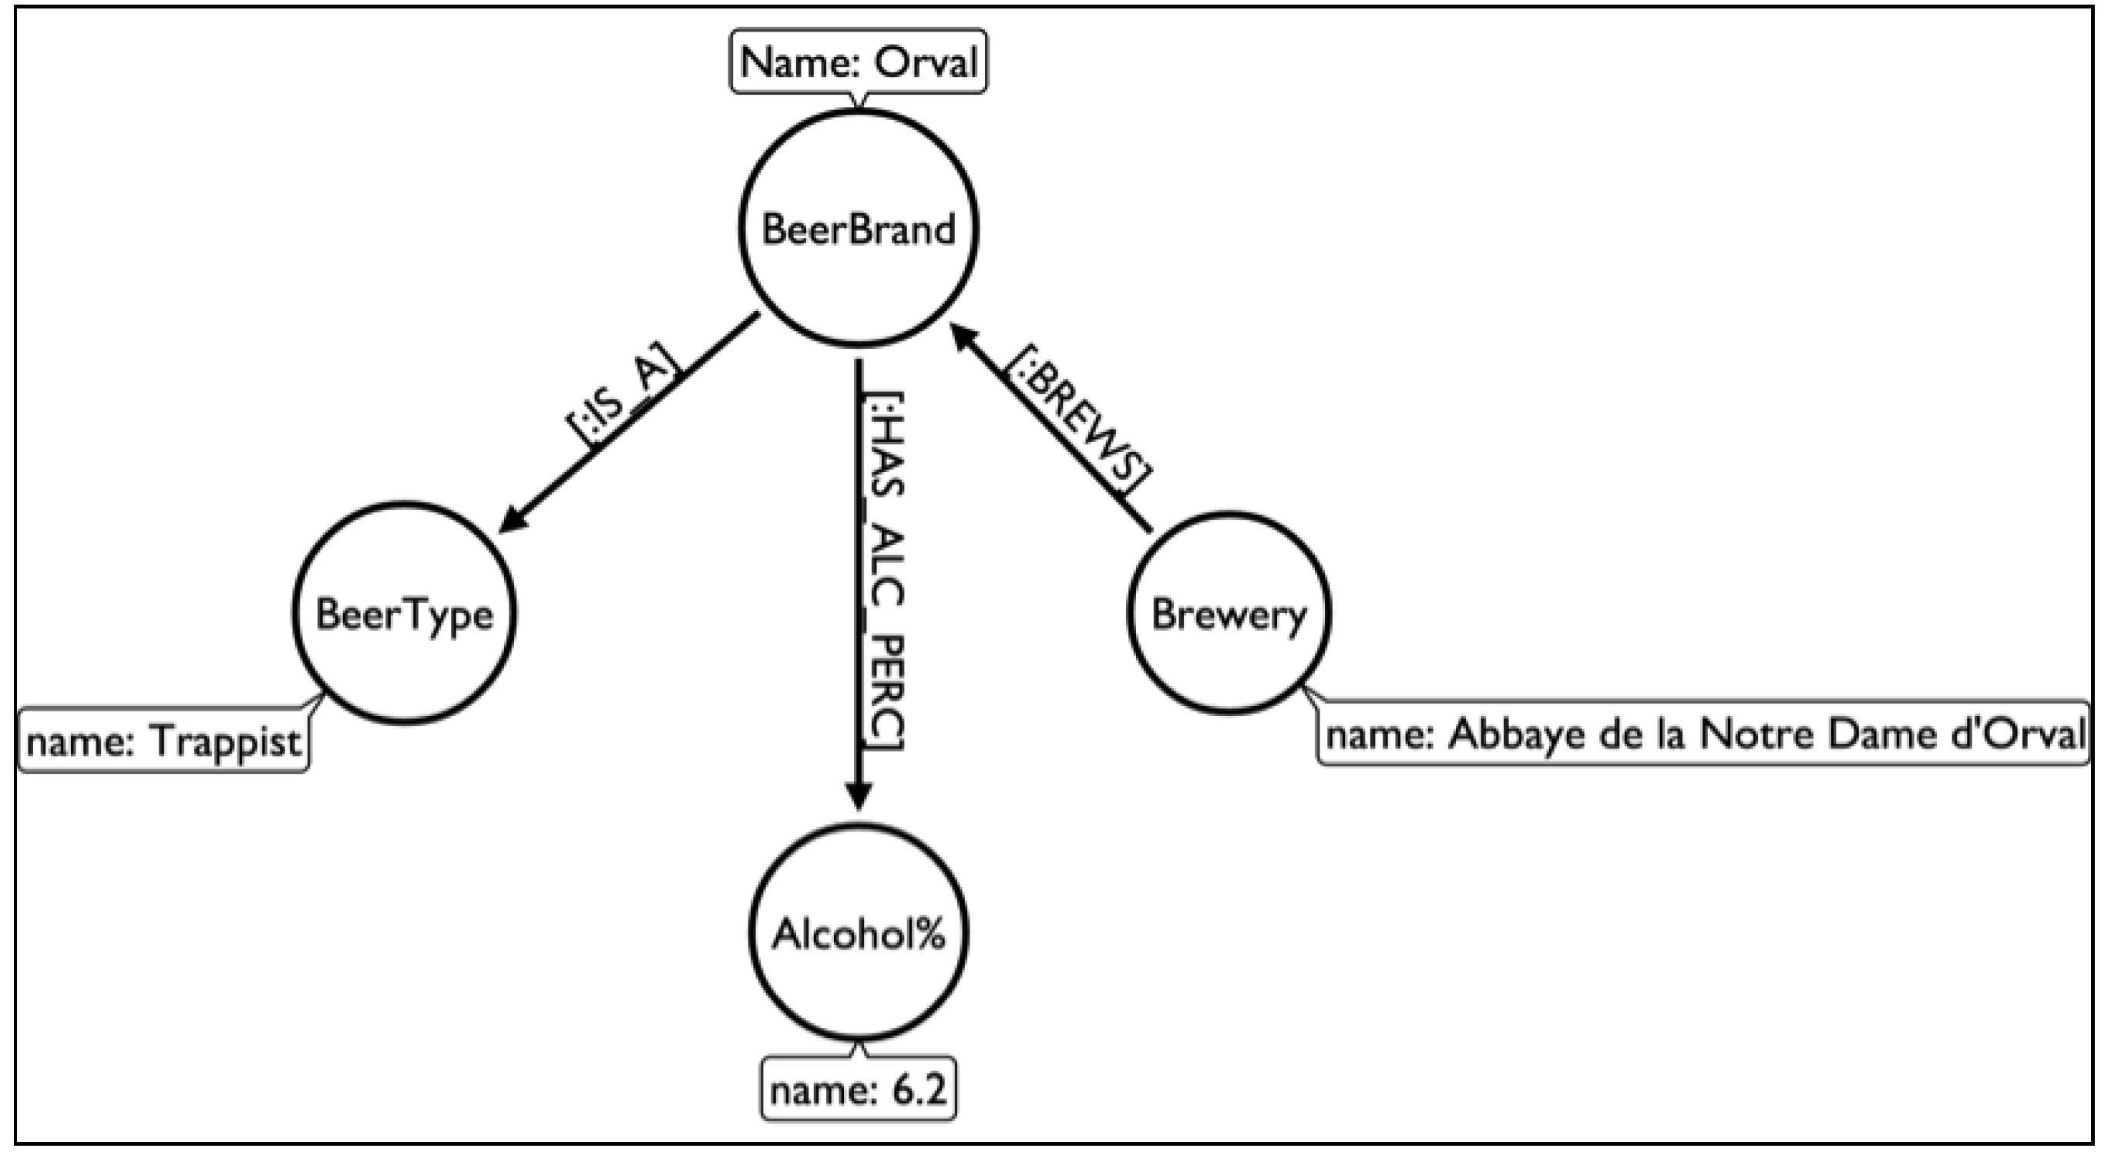
Granulating (value) nodes

Slide 13
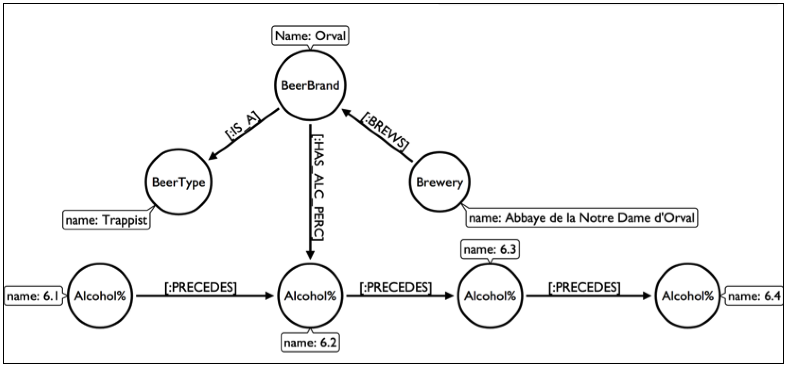
In-graph index

Slide 14
Schema?
There is no schema as such in neo4j
Any schema is documentation on how you should use the data model
There is no way to constrain the model
Except for a few constraints

Slide 15
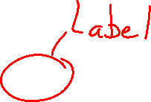
Constraints
Unique
CREATE CONSTRAINT book_isbn FOR (book:Book) REQUIRE book.isbn IS UNIQUE
Not null (enterprise only)
CREATE CONSTRAINT author_name FOR (author:Author) REQUIRE author.name IS NOT NULL
CREATE CONSTRAINT year FOR ()-[wrote:WROTE]-() REQUIRE wrote.year IS NOT NULL
Primary key (enterprise only)
CREATE CONSTRAINT book_isbn FOR (book:Book) REQUIRE book.isbn IS NODE KEY

Slide 16
Creating data
You create data by specifying one or more patterns
That means you can create a lot of data in a single statement
CREATE statement: Creates everything in the patterns given
MERGE statement: Only create the data if the pattern doesn't already exist
Note: If some of the pattern exists but not all, MERGE still creates everything like CREATE

Slide 17
CREATE
CREATE (:Employee {name: "John Doe"}) -[:WORKS {since: date("2019-06-01")}]-> (:Company {name: "Standard inc."});
Creates both employee, company and relationship
Also works the opposite way
CREATE (:Company {name: "Standard inc."}) <-[:WORKS]- (:Employee {name: "John Doe"});

Slide 18
MERGE
MERGE (:Employee {name: "John Doe"}) -[:WORKS]-> (:Company {name: "Standard inc."});
If employee, company and the works relationship all exist, do nothing
If just one of them doesn't exist, create all three

Slide 19
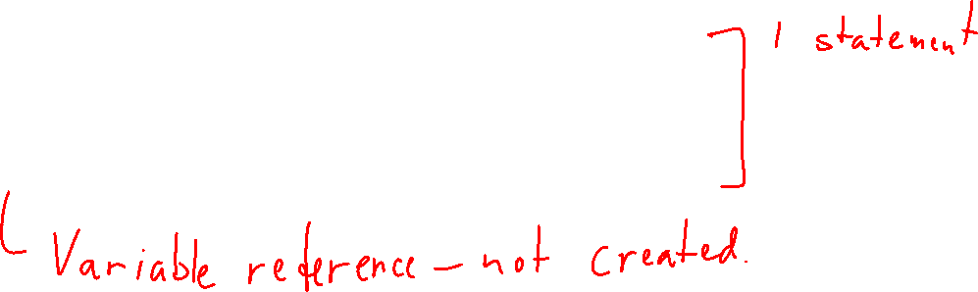
Create only necessary elements
MERGE (e:Employee {name: "Jane Roe"})
MERGE (c:Company {name: "Standard inc."})
MERGE (e)-[:WORKS]->(c);
e and c are references
(Note: This is one statement)

Slide 20
Similar, but …
MATCH (e:Employee {name: "Jane Roe"}), (c:Company {name: "Standard inc."})
MERGE (e)-[:WORKS]->(c);
Only adds relationship if employee and company exist

Slide 21
Creating more with an advanced pattern
CREATE (:Employee {name: "John Doe"}) -[:WORKS]-> (:Company {name: "Standard inc."})
<-[:WORKS]-
(:Employee {name: "Jane Roe"});

Slide 22
Probably more readable
CREATE (c:Company {name: "Standard inc."}), (:Employee {name: "John Doe"}) -[:WORKS]-> (c),
(:Employee {name: "Jane Roe"}) -[:WORKS]-> (c);

